Slide 1


LGMK CIC BUILD UP
Manager & User Guide
LGMK-CIC-DE-01
Ver1.5
Department in charge: CIC Solution Team
Copyright ⓒ LG CNS It is prohibited to copy, reproduce or distribute any or all of the contents of this document without prior permission from LG CNS.
LG CNS | LGMK
Hui-Joong, Chae (sign) | Balazs Sagi (sign)

Slide 2
Revision History
Version | Created on | Revised Content | Revised by | Approved by
1.0 | 2012.08.01 | First written | Sang-Joo, Lee | Hui-Joong, Chae
1.1 | 2012.08.07 | Contents update | Sang-Joo, Lee | Hui-Joong, Chae
1.2 | 2012.08.20 | Contents update | Sang-Joo, Lee | Hui-Joong, Chae
1.3 | 2012.08.22 | Contents update | Sang-Joo, Lee | Hui-Joong, Chae
1.4 | 2012.08.27 | Contents update | Sang-Joo, Lee | Hui-Joong, Chae
1.5 | 2012.08.27 | Contents update | Sang-Joo, Lee | Hui-Joong, Chae

Slide 3
INDEX
Ⅰ. nx Switch(PBX)
Ⅱ. nx IVR
1. Access management page
2. Screen configuration
Configuration
Policy
Trunk
Monitoring
Account
1. IVR Default Setting
2. IVR Ment Setting
Ment by Day and Time Set
IVR Trunk Set
Source Upload
Source Setting for Groups
Ⅲ. nx VRS
Ⅳ. nx Board
1. Execution & Log in
2. Screen Configuration
3. Data Retrieval
4. Data List
5. Listening
1. Execution & Log in
2. Setting
3. Board Screen – Total Call Status
4. Board Screen – Total Status
5. Board Screen – Site Status
6. Board Screen – Site Agent Call Status
Notes:
2

Slide 4
Ⅰ. nx Switch(PBX)

Slide 5
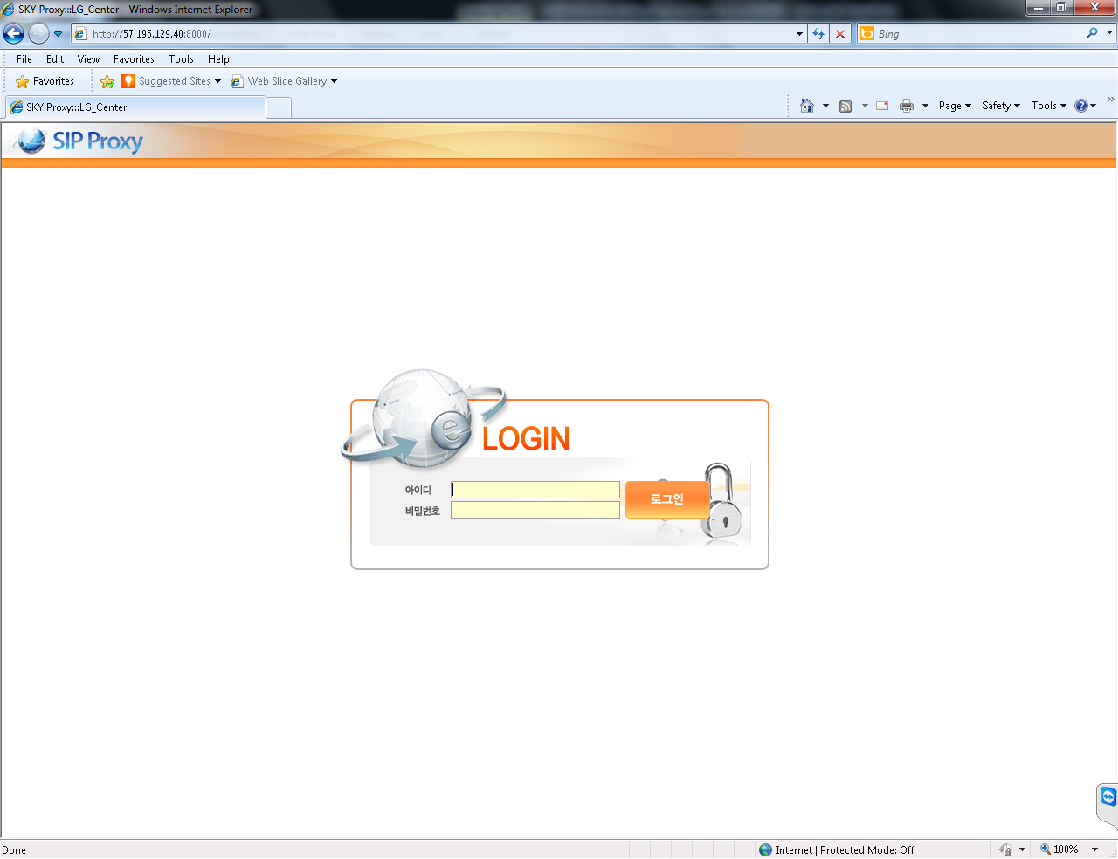
I. nx Switch(PBX)
1. Access management page
1. Type in the address bar ‘http://57.195.129.40:8000’ and Enter, the login screen appears.
2. Granted Username, Password and then click the login button to enter.
(default username: admin / default password: admin)

Slide 6
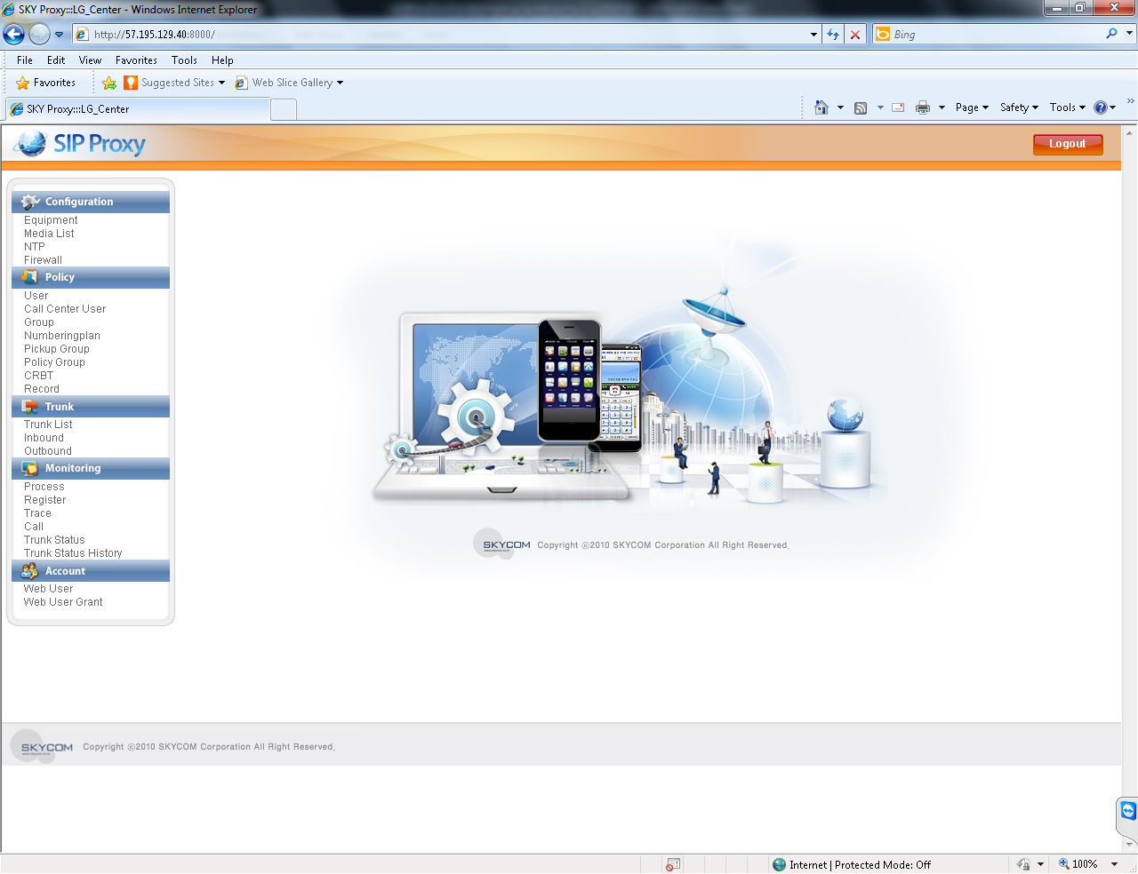
I. nx Switch(PBX)
2. Screen Configuration
Configuration – Server operating information
Logout button
Policy – Service policy
Trunk – Integration with the outside
Monitoring
Account – Administrator setting

Slide 7
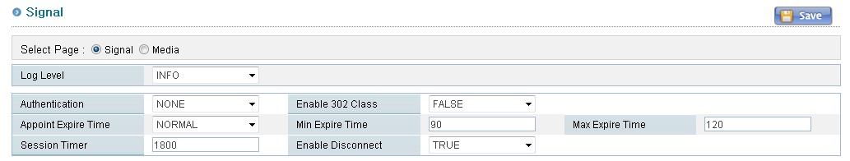
I. nx Switch(PBX)
3. Configuration – Equipment(/Signal)
Save button
LOG LEVEL | Setting the log level (DEBUG/INFO/NOTICE/WARRING)
AUTHENTICATION | Setting the authentication method for call NONE: No authentication UNREGISTER: Additional authentication for unregistered users ALL: Additional authentication for all users
Enable 302 Class | Setting whether to use the phone's forwarding service(Basic: DEFAULT)
APPOINT EXIRE TIME MIN EXPIRE TIME MAX EXPIRE TIME | Setting method about REGISTER registration cycle NORMAL: REGISTER EXPIRES time does not exceed MAX, set the amount of time specified by the user, and does exceed MAX, set the MAX EXPIRE TIME. RANDOM: MIN / MAX EXIRE TIME between the values of a random set ** Private network user, specify the MIN EXPIRE TIME
SESSION TIMER | Check cycle for calls that are connected
ENABLE DISCONNECT | When UNREGISTER during user’s call, decide whether call termination

Slide 8
I. nx Switch(PBX)
3. Configuration – Equipment(/Signal)
MEDIA I/F ADDRESS1 MEDIA I/F ADDRESS2 MEDIA I/F PORT | Setting signal server interface information for sending and receiving message from media server If a single server, IP address is the same as MEDIA I / F ADDRESS1/MEDIA I / F ADDRESS2
MEDIA RELAY | Media relay setting NONE: Do not use the media relay ALL : All user USER : Extension user PRIVATE: Private network user ** If you set the recording, use media relay.
VMS WAIT TIME | Unused

Slide 9
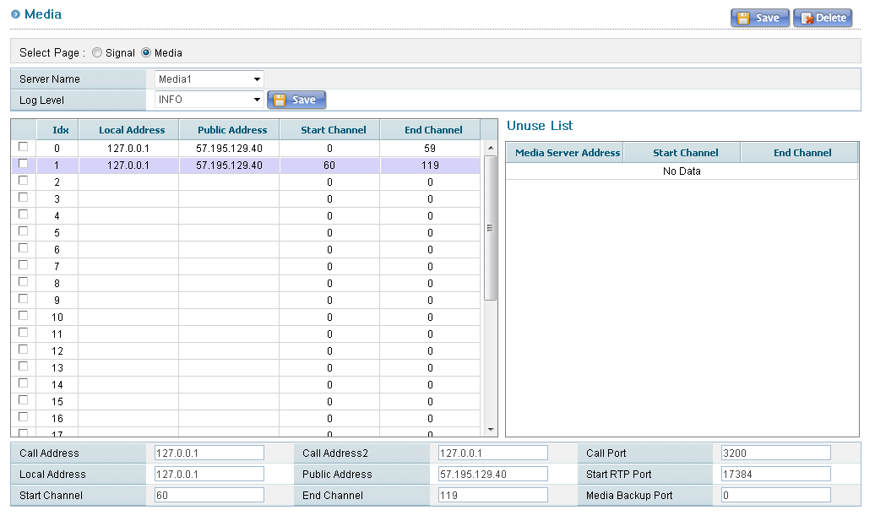
I. nx Switch(PBX)
3. Configuration – Equipment(/Media)
Save/Delete button
Select media server
Save log level button
Media information
that set in the signal server,
but not use in the media server
Information in the media server

Slide 10
I. nx Switch(PBX)
3. Configuration – Equipment(/Media)
CALL ADDRESS1 CALL ADDRESS2 CALL PORT | Interface information about call processing server
LOCAL ADDRESS PUBLIC ADDRESS | Media server's IP address to transferred to extension or external LOCAL ADDRESS: Registered users within or internal service PUBLIC ADDRESS: Registered users from outside or extension user
START RTP PORT | RTP port address used by media server
START/END CHANNEL | Channel bandwidth to handle media server
MEDIA BACKUP PORT | Unused

Slide 11
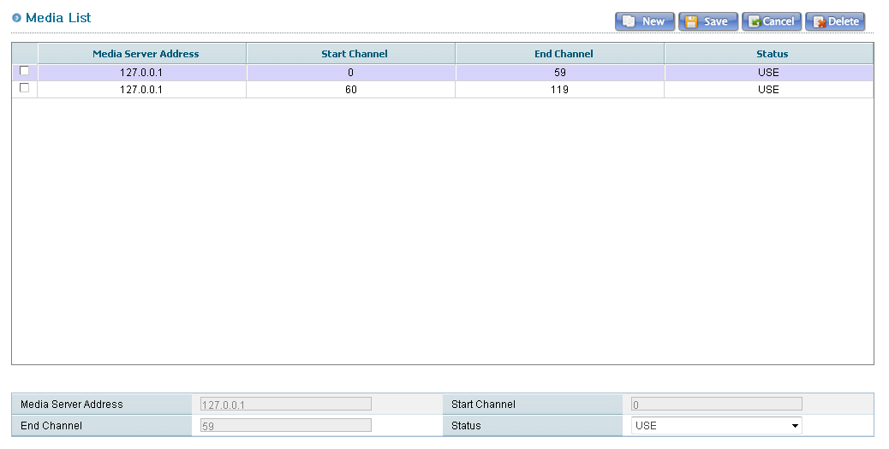
I. nx Switch(PBX)
3. Configuration – Media List
Media server list for use in call processing server
NEW SAVE CANCEL DELETE | Buttons for add/edit/delete to media list information NEW: Initialization to enter a new media list information SAVE: Saving information entered to media list information entry CANCEL: Initialization media list information in creating DELETE: Deletion selected media list

Slide 12
I. nx Switch(PBX)
3. Configuration – Media List
MEDIA SERVER ADDRESS | Media server address that is used by Call-processing server
START/END CHANEL | Channel information that is used by call-processing server
STATUS | Media server's status UNUSE: No media servers that is used PAUSE: Disabled (not incoming call to the specified channel) USE: Being used in the media server by specifying

Slide 13
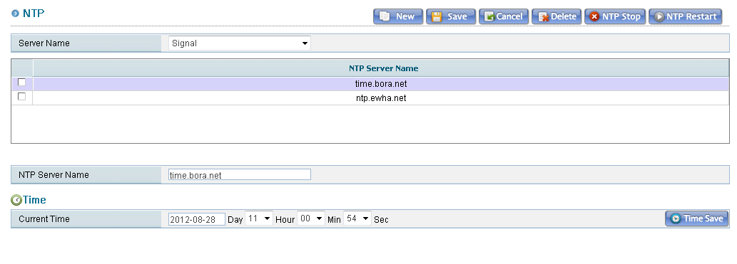
I. nx Switch(PBX)
3. Configuration – NTP
Select the server to set the NTP server
A list of NTP servers configured on the server
Enter the NTP server.
NEW SAVE CANCEL DELETE NTP STOP NTP RESTART | Buttons for add/edit/delete to NTP server information NEW: Initialization NTP SERVER NAME to enter a new NTP server information SAVE: Saving information entered to NTP SERVER NAME CANCEL: Initialization NTP SERVER NAME enter windows in creating DELETE: Delete the selected NTP server list NTP STOP: Stop the NTP 데몬(?) on the server NTP RESTART: Restart the NTP 데몬(?) on the server
TIME SAVE | Apply to the server, set time to CURRENT TIME

Slide 14
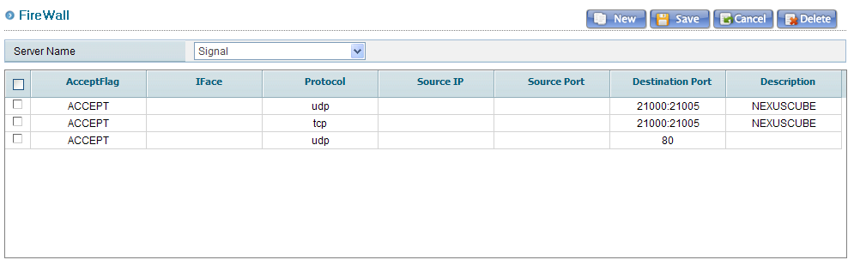
I. nx Switch(PBX)
3. Configuration – Firewall
Select the server for firewall settings
NEW SAVE CANCEL DELETE | Button for add/edit/delete to firewall setting information NEW : Enter the new firewall information SAVE : Save the firewall setting CANCEL : Initialization the firewall setting enter windows in creating DELETE : Delete the selected firewall setting information

Slide 15
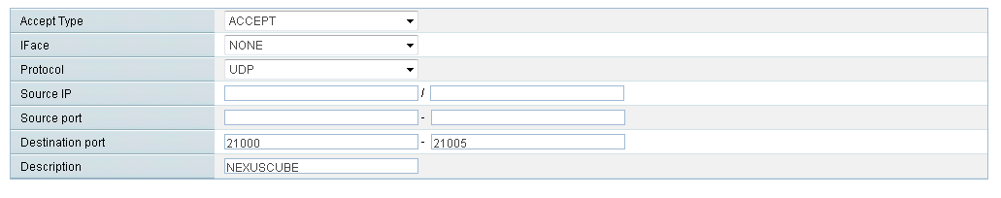
I. nx Switch(PBX)
3. Configuration –Firewall
ACCEPT TYPE | Firewall policy setting ACCEPT: Allowed DROP: Blocked
IFACE | Network interface setting NONE: All interface ETHERNET INTERFACE NAME: Network interface to apply the policy
PROTOCOL | Protocol Settings NONE: All protocol UDP/TCP: Protocol type to apply the policy
SOURCE IP | IP addresses access to server
SOURCE PORT | Port information access to server
DESTINATION PORT | Port used by server
DESCRIPTION | Description

Slide 16
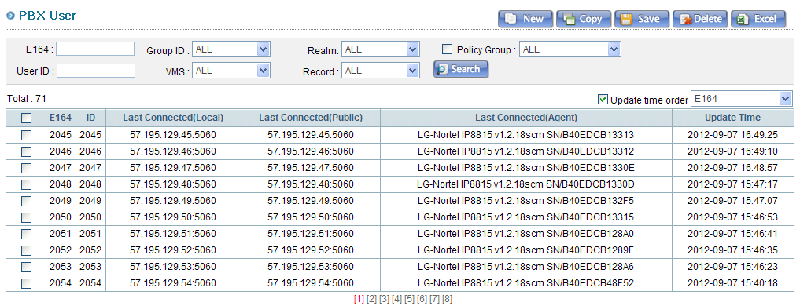
I. nx Switch(PBX)
4. Policy – User
Buttons to the user information input / edit / delete
User search using the search conditions
The total number of user information input

Slide 17
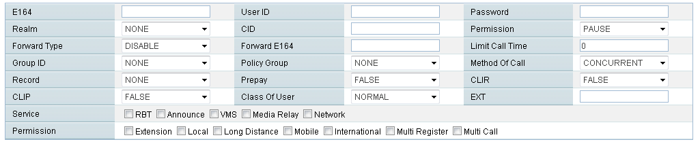
I. nx Switch(PBX)
4. Policy – User
User account information | E164 (Phone number)/USER ID/PASSWORD/REALM (Domain)
CID | Caller ID service
PERMISSION | User terminal authority PAUSE/SENDRECV/SENDONLY/RECVONLY DECLINE: Deny of registration
FORWARD TYPE FORWARD E164 | Call forwarding method and call forwarding phone number DISABLE/ALL/BUSY/TIMEOUT/UNREGISTER
LIMIT CALL TIME | Maximum call time (0: unlimited)
PICKUP GROUP | PICKUP Group Information
POLICY GROUP | Policy group information
METHOD OF CALL | Call connected method for registered users concurrent enrollment (MULTI-REGISTER USER) CONCURRENT/SEQUENCE
RECORD | Recording service

Slide 18
I. nx Switch(PBX)
4. Policy – User
PREPAY | Prepay service
CLIR | Calling Line Identification Restriction
CLIP | Calling Line Identification Presentation
CLASS OF USER | Users type - NORMAL/ENTERPRISE/CALLCENTER/IVR/WHOLESALE
EXT | Shorten the extension number
SERVICE | Additional service CRBT ANNOUNCE : Change notification VMS : Does not support MEDIA RELAY : Support media relay service to the public IP users NETWORK : Service that recognize public IP users to private network
CALL PERMISSION | Call allow policy setting EXTENSION: LOCAL: LONG DISTANCE: MOBILE: INTERNATIONAL: MULTI REGISTER: MULTI CALL:

Slide 19
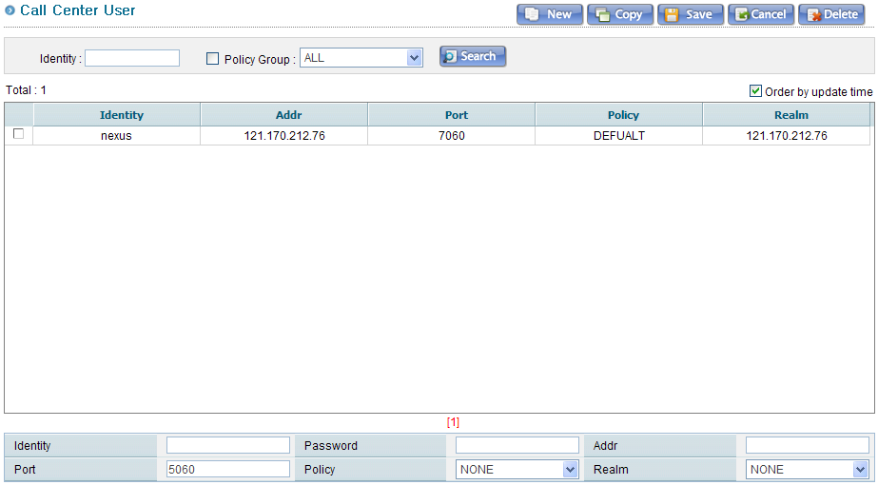
I. nx Switch(PBX)
4. Policy – Call Center User
Buttons to CALL CENTER account, enter/edit/delete
Search button CALL CENTER account
CALL CENTER account list
IDENTITY/PASSWORD | CALL CENTER log in information
ADDR/PORT | Not used
POLICY REALM | Policy group and domain contains CALL CENTER group Send and receive information about extension and QUEUE belonging to the same policy group and domain

Slide 20
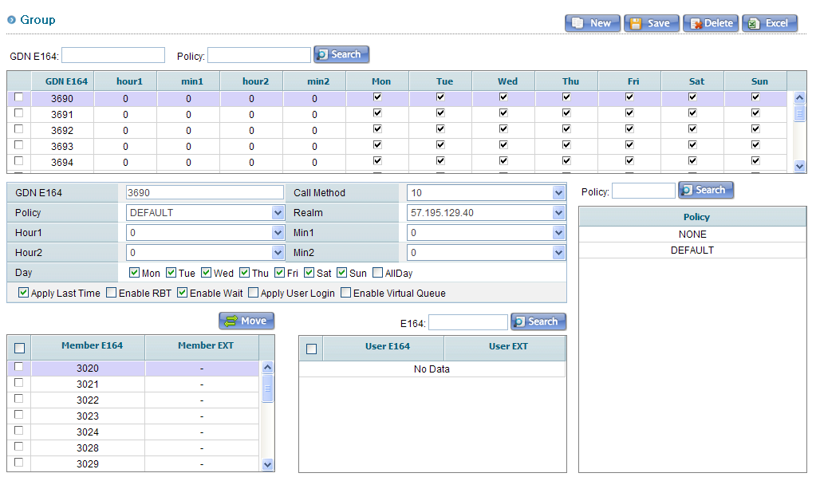
I. nx Switch(PBX)
4. Policy – Group
Buttons to group information input/edit/delete
Groups search button
Button to move the extension number
Policy group list
Group list
(Changed the order of priority according to)
Extension list

Slide 21
I. nx Switch(PBX)
4. Policy – Group
GDN E164 | Representative number (must be set extension band in numbering plan)
CALL METHOD | Call method extension number belonging to group Concurrent calls Sequential call : If there is no response within a specified time and then call next extension.(10/15/30)
POLICY/REALM | Policy group and domain of representative number
HOUR1/MIN1 HOUR2/MIN2 | Setting service available time (If any item is zero, no time limit) HOUR1/MIN1: Start time HOUR2/MIN2: End time
DAY | Specify service available day of week
OPTION | Detailed setting representative number APPLY LAST TIME: Specify the priority calling considering the phone response time ENABLE RBT: Specify CRBT functions to representative number ENABLE WAIT: If all extension belonging to representative number is busy, wait until the call has ended APPLY USER LOGIN: In the current server does not support ENABLE VIRTUAL QUEUE: Virtual number of callers waiting (CTI interworking required)

Slide 22
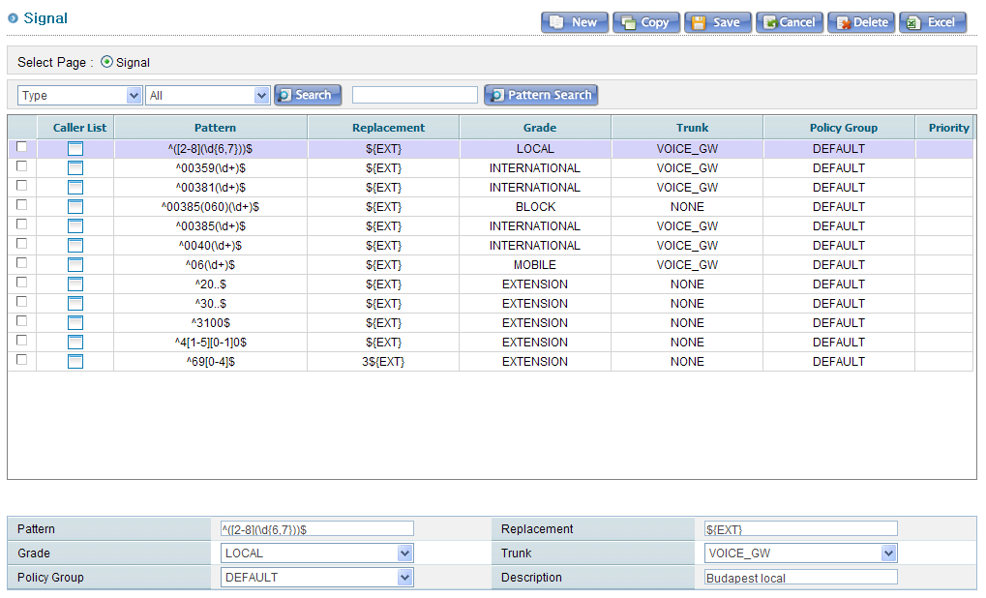
I. nx Switch(PBX)
4. Policy – Numbering Plan
Buttons to Policy input/edit/delete
Policy Search button
Policy priority search button
Policy list

Slide 23
I. nx Switch(PBX)
4. Policy – Numbering Plan
PATTERN | Pattern for set the routing (Use Regular Expression )
REPLACEMENT | Change policy input PATTERN(PREFIX Add/modify/delete) ${EXT} → Default 070${EXT} → Add to phone number PREFIX 070 (ex : 12345678 → 07012345678) ${EXT}90 → Add to phone number POSTFIX 070 (ex : 12345678 → 1234567890) ${EXT:3} → Delete before the three-digit phone number (ex : 07012345678→ 12345678) ${EXT:-3} → Delete behind the three-digit phone number (ex : 07012345678→ 07012345)
GRADE | CALL PERMISSION setting (In connection with the user's CALL PERMISSION) EXTENSION/LOCAL/LONG/MOBILE/INTERNATIONAL (CALL PERMISSION) PICKUP: Pickup specific extension belongs to a group specified PICKUP group GROUP-PICKUP: Pickup belongs to a group specified PICKUP group CALLER-GDN: Change Caller number (USER's CID is a high priority) CALLED-GDN: Change Recipients number TRUNK-EXTENSION: Extension is set to different server EXCEPT-EXTENSION: Not treated as an extension for a certain number SERVICE: Treated as IVR and service number for a certain number BLOCK: Service Limited for a certain number LOGIN/LOGOUT: Unsupported
TRUNK | Specify TRUNK group to be used for the connection, If the external caller
POLICY GROUP | POLICY GROUP is applied routing policy

Slide 24
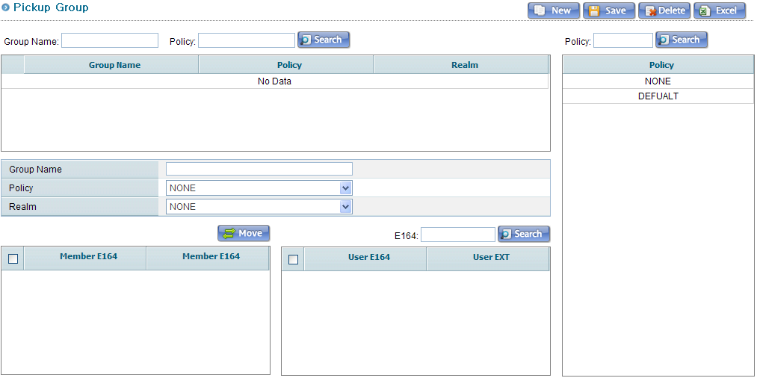
I. nx Switch(PBX)
4. Policy – Pickup Group
Buttons to PICKUP information input/edit/delete
PICKUP group search button
PICKUP group list
Policy group list
PICKUP Specify the group name
PICKUP, POLICY group
PICKUP group domain
Button to move the extension number
PICKUP extension list
Extension list
Automatically reflected PICKUP GROUP of user, when pickup group is set

Slide 25
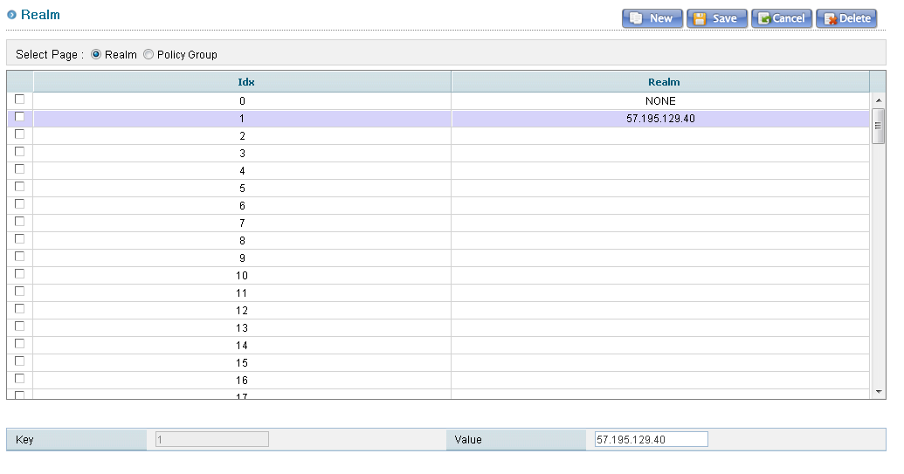
I. nx Switch(PBX)
4. Policy – Realm
Buttons to REALM information input/edit/delete
REALM list (Can be specified up to 128 )
Domain-Specification
** REALM is related user REGISTER and CALL CENTER function

Slide 26
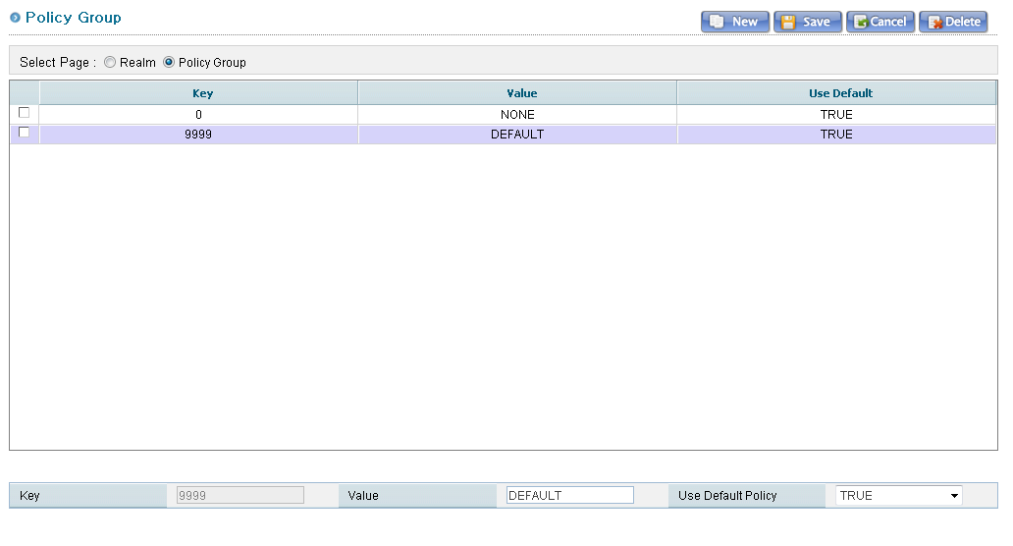
I. nx Switch(PBX)
4. Policy – Policy Group
Buttons to POLICY information input/edit/delete
POLICY list (KEY 0 and 9999 is default)
KEY: Random number between 1 to 9998
VALUE: POLICY group name
Whether to use DEFAULT POLICY group

Slide 27
I. nx Switch(PBX)
4. Policy – CRBT

Slide 28
I. nx Switch(PBX)
4. Policy – CRBT

Slide 29
I. nx Switch(PBX)
4. Policy – CRBT

Slide 30
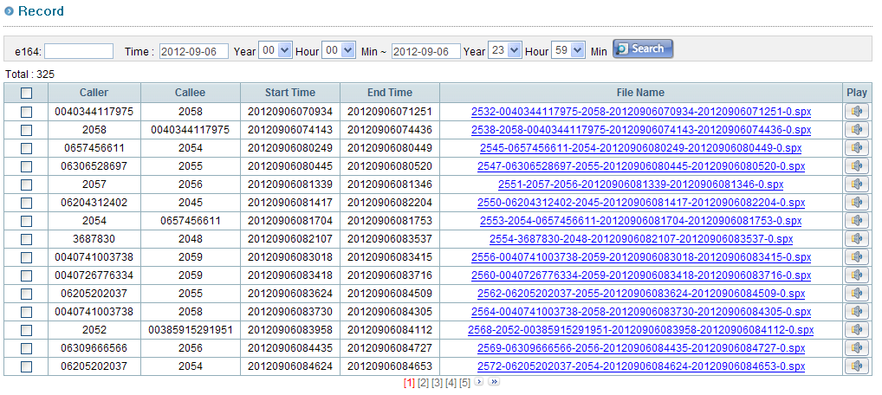
I. nx Switch(PBX)
4. Policy – Record
Record Search button
Download Record-file
Play Record-file

Slide 31
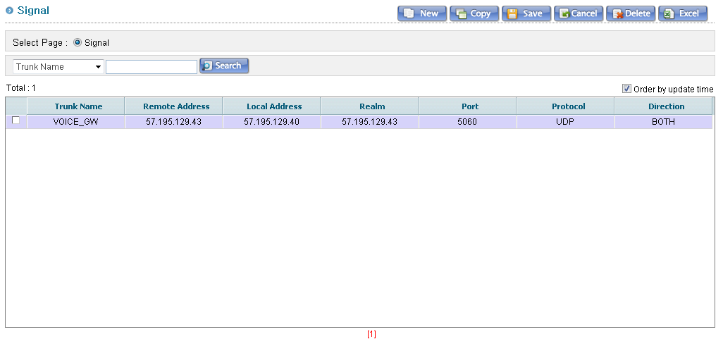
I. nx Switch(PBX)
5. Trunk – Trunk List

Slide 32
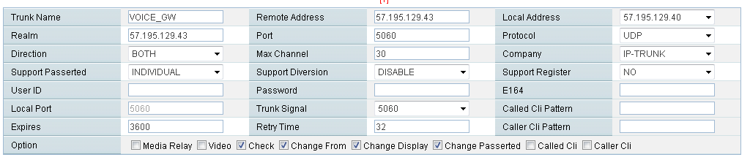
I. nx Switch(PBX)
5. Trunk – Trunk List
TRUNK NAME | Name or alias of linkage server
REMOTE ADDRESS REALM PORT | Linkage server information REMOTE ADDRESS/PORT: Transmission information of SIP message REALM: Domain information (If you do not use, enter the IP)
LOCAL ADDRESS | IP information for use in internal server
PROTOCOL | Linkage Protocol(UDP/TCP/TLS)
DIRECTION | Linkage method (INBOUND/OUTBOUND/BOTH) Can be set INBOUND/OUTBOND TRUNK in according to the linkage method
MAX CHANNEL | Number of linkage channel
INTERWORKING | SIP linkage method IP-TRUNK: General linkage method SIP-CONNECT: Sending method to FROM field specified E164

Slide 33
I. nx Switch(PBX)
5. Trunk – Trunk List
SUPPORT P-ASSERTED | P-ASSERTED, Whether to use the field
SUPPORT DIVERSION | DIVERSION, Whether to use the field
SUPPORT REGISTER | Registration to linkage server using REGISTER message
USER ID PASSWORD E164 EXPIRES RETRY TIME | Account information and environment about linkage server USER ID/PASSWORD/E164: Account information EXPIRES: REGISTER EXPIRES TIMES RETRY TIME: REGISTER retransmission cycle, when it fails
LOCAL PORT | Internal SIP service port
TRUNK SIGNAL | TRUNK information to link with external server (In many calls, used to call traffic distribution)
CALLED CLI PATTERN | Recipient number identification pattern(Use Regular Expression)
CALLER CLI PATTERN | Caller number identification pattern (Use Regular Expression)
OPTION | MEDIA RELAY: Media relay service (Not supported by default) VIDEO: VIDIO service CHECK: Interworking server HEARTBEAT check CHANGE FROM: Change FROM field CHANGE DISPLAY: Change the value of the DISPLAY FROM field CHANGE P-ASSWERTED: Change P-ASSERTED field CALLED CLI: CALLED CLI whether to use CALLER CLI: CALLED CLI whether to use
CALLED CLI / CALLER CLI option is used to identify server, when linkage server is using the same IP and port

Slide 34
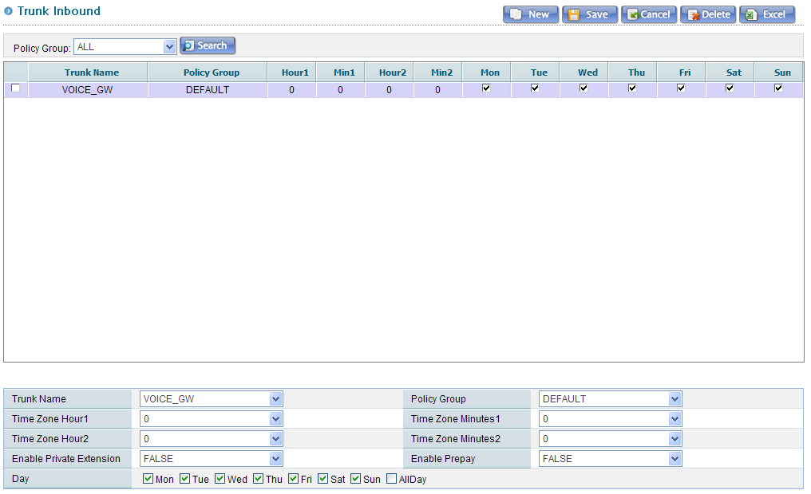
I. nx Switch(PBX)
5. Trunk – Inbound

Slide 35
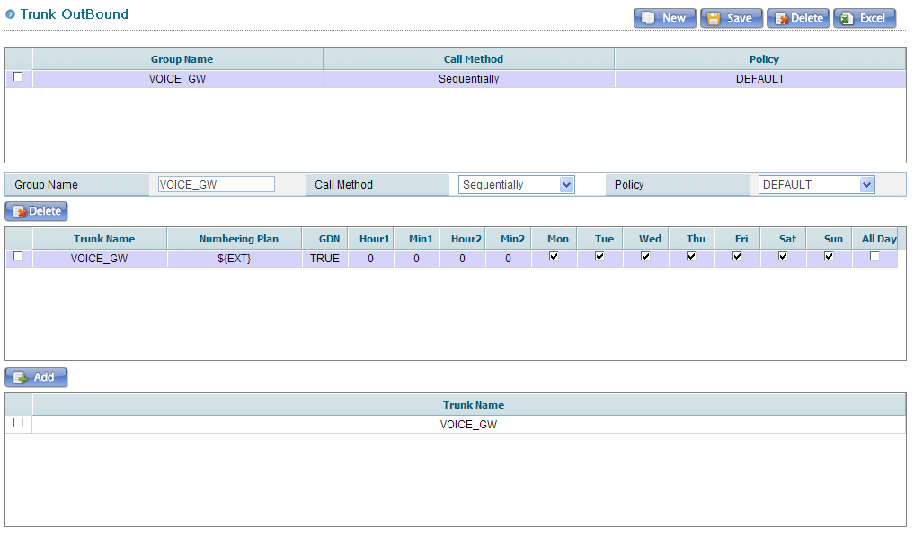
I. nx Switch(PBX)
5. Trunk – Outbound
OUTBOUND group list
Server list included in the selected OUTBOUND group
OUTBOUND server list

Slide 36
I. nx Switch(PBX)
5. Trunk – Outbound
GROUP NAME | Group to display name in the NUMBERING PLAN
CALL METHOD | Method of server call LOADBALANCE SEQUENCE
POLICY | OUTBOUND Group's Policy Group
NUMBERING PLAN | Recipients number change (is the same as NUMBERING PLAN’s REPLACEMENT)
GDN | Whether to change service support caller ID of NUMBERING PLAN to representative number Set to FALSE, if IVR server linked method of TRUNK
HOUR1/HOUR2 MIN1/MIN2 | Specify the available time to linkage server

Slide 37
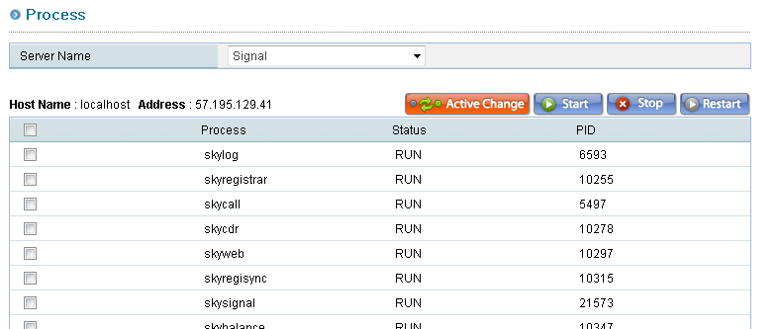
I. nx Switch(PBX)
6. Monitoring – Process
List of running process
HOST NAME ADDRESS | Server information
ACTIVE CHANGE | Switch to ACTIVE / STANDBY When server is set to ACTIVE / STANDBY
START/STOP/RESTART | Button to process Start / Stop / Restart

Slide 38
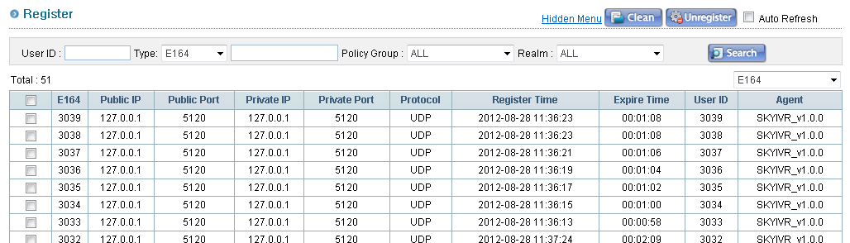
I. nx Switch(PBX)
6. Monitoring – Register
E164/USER ID | Extension number/User ID
PUBLIC IP/PORT | IP information terminals connected
PRIVATE IP/PORT | IP information specified in the terminal
PROTOCOL | Using protocol
REGISTER/EXPIRE TIME | Registered the time and valid time registered terminal
AGENT | Terminal name

Slide 39
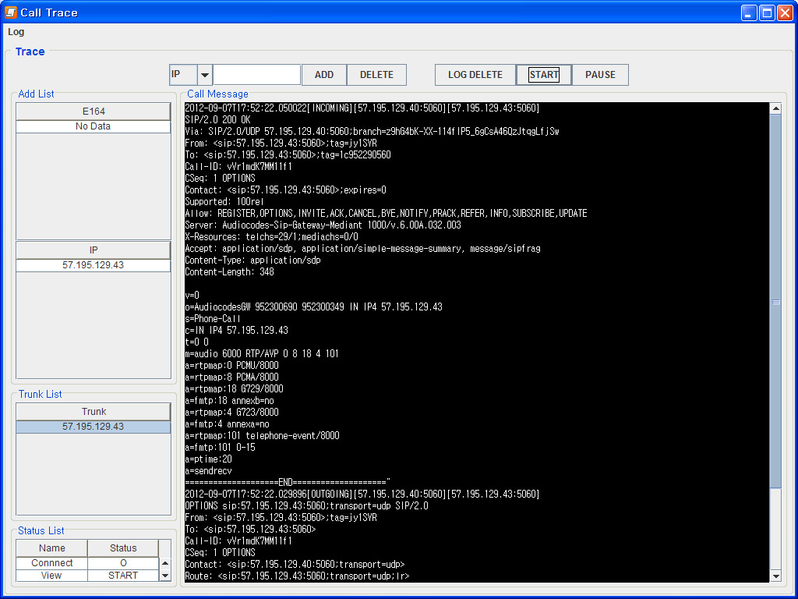
I. nx Switch(PBX)
6. Monitoring – Trace
Monitored Phone number
Monitored Server
SIP message LIST

Slide 40
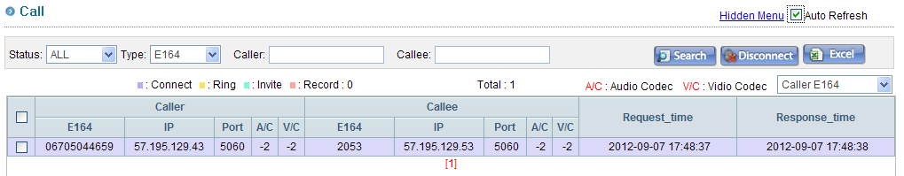
I. nx Switch(PBX)
6. Monitoring – Call
E164 | Caller / recipient phone number
IP/PORT | Caller / recipient access information
A/C & V/C | Audio / video codec of caller /recipient
REQUEST TIME | Call start time
RESPONSE TIME | Call response time

Slide 41
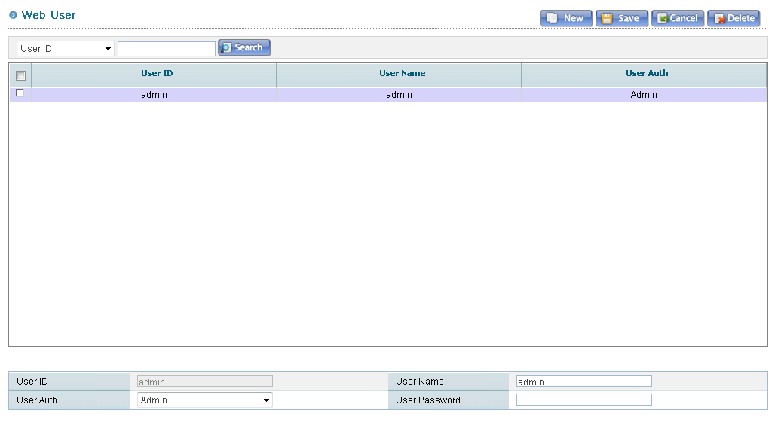
I. nx Switch(PBX)
7. Account – Web User
Web Administrator List
USER ID/PASSWORD | Account information
USER NAME | User name
USER AUTH | User authentication User authentication can be set in WEB USER GRANT

Slide 42
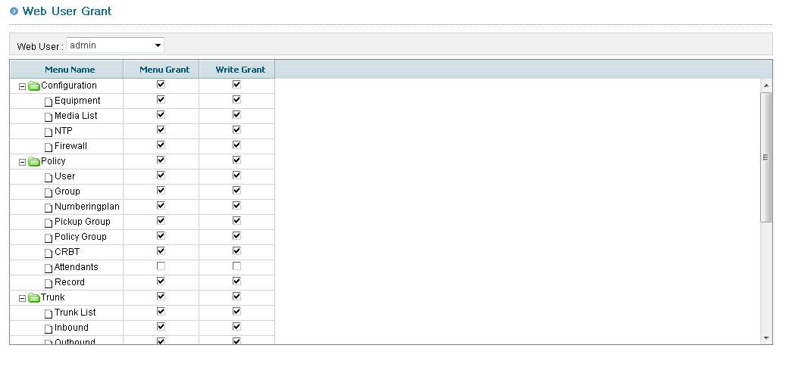
I. nx Switch(PBX)
7. Account – Web User Grant
Set your permission

Slide 43
Ⅱ. nx IVR

Slide 44
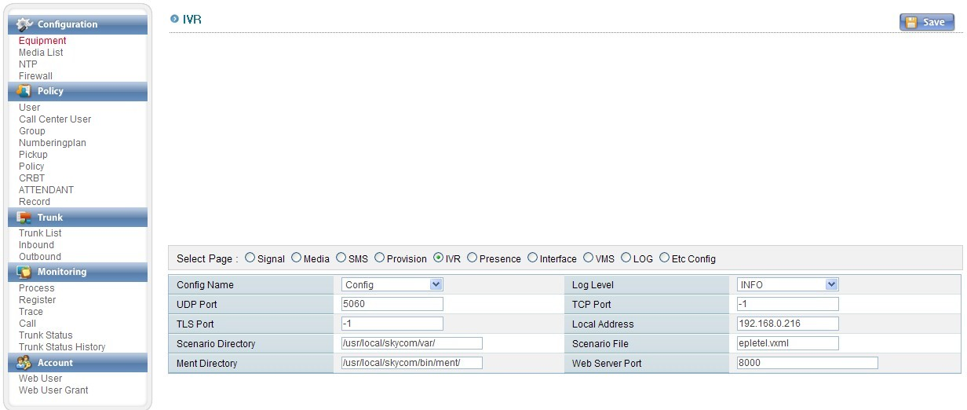
II. nx IVR
1. IVR Default Setting
New
Delete
List the IVR setting
Idx
Description
upload

Slide 45
II. nx IVR
1. IVR Default Setting
Idx | Index
Log Level | Setting Log level
UDP Port | IVR Port
TCP Port | 0
TLS Port | 0
Local Address | Local IP
Scenario Directory | Scenario file path
Ment Directory | Ment file path
Upload | Scenario file upload
Description | Description

Slide 46
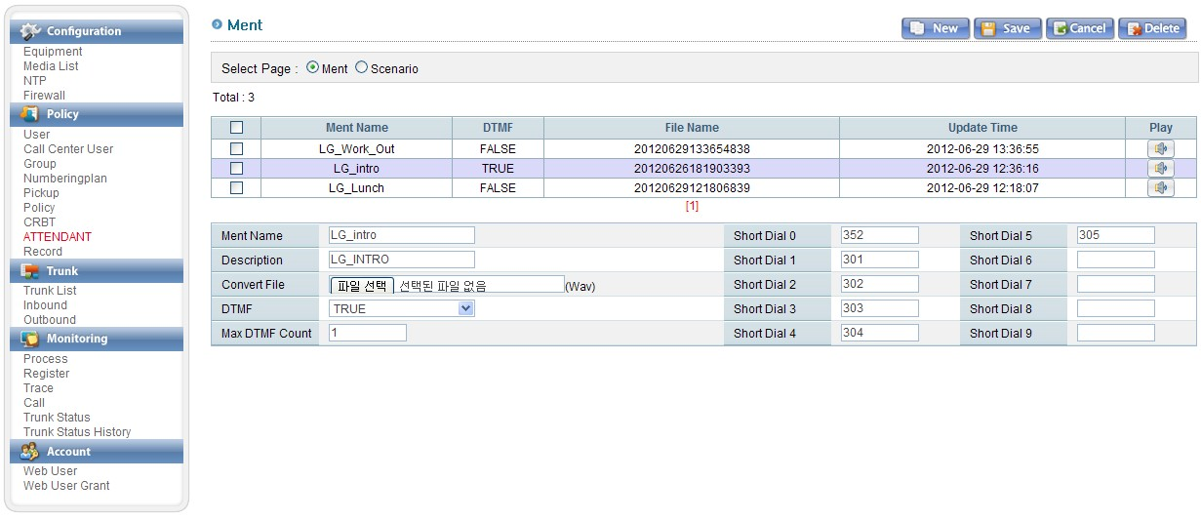
II. nx IVR
1. IVR Ment Setting
Display a list settings
Outbound
Basic Dial
Retry key
Ring File
Source and outbound settings
Dial setting

Slide 47
II. nx IVR
1. IVR Ment Setting
Ment name | Ment name be displayed on the list
Description | Comments about that ment
Convert file | Incoming call, the first ment to upload a file
DTMF | DMF use scenario is TRUE, unless FALSE
Max DTMF Count | If you are using DMF, set to receive a few digits of DTMF - Set to 0, if you don’t use DTMF
Outbound | - Outbound use scenario is TRUE, unless FALSE - ex) Working hours is TRUE, non-working hours is FALSE
Ring File | Ling file be played during the outbound
Basic Dial | Outbound number by default
Retry Key | DTMF setting coment replay

Slide 48
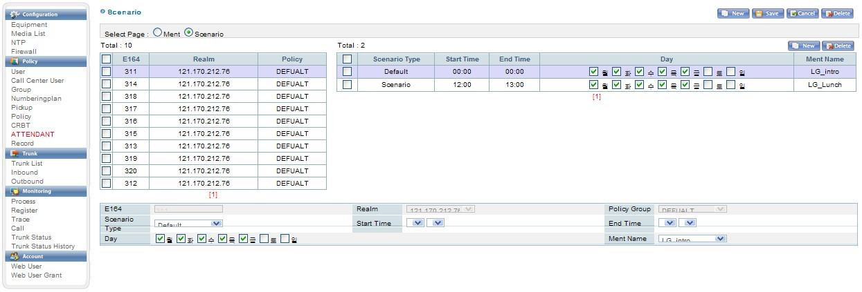
II. nx IVR
2. Ment By Day & Time Set

Slide 49
II. nx IVR
2. Ment By Day & Time Set
E164
Realm
Policy Group | Groups of that number
Scenario Type | Separated by default or scenario type
Start Time | The start time that scenario is valid, the time interval
End Time | The end time that scenario is valid, the time interval
Day | Set the day of the week

Slide 50
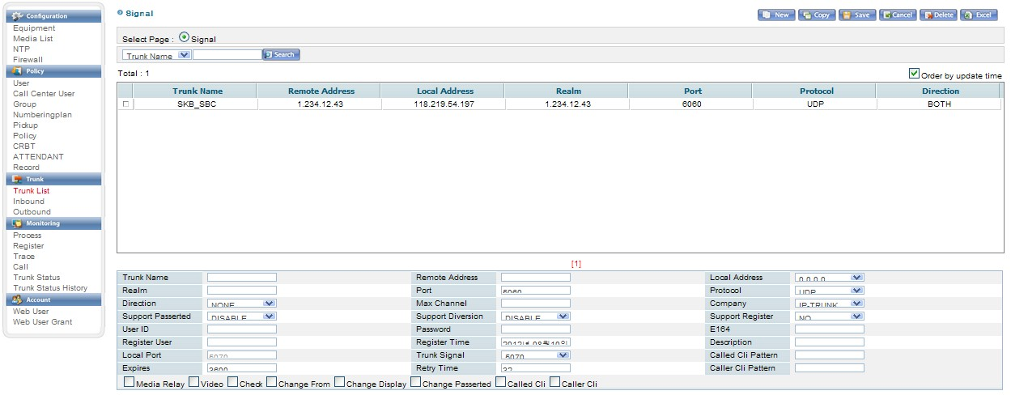
II. nx IVR
3. IVR Trunk Setting
Ivr Trunk List
Process_idx
Call trasfer type

Slide 51
II. nx IVR
3. IVR Trunk Setting
Process Idx | IVR to run multiple, set up to be able to read their TRUNK information IVR index
Realm
Port | Trunk port
Protocol
Remote Address | PBX IP
Local Address | Local IP
Max Channel | Maximum channel of Trunk
Support Register | Flag about how to register with that information to PBX
User ID | IP of the account register
Password | PW of the account register
Register Time | Account the time of registration
Transfer Type | Distinguish call switching method (trunk method or REFER method)

Slide 52
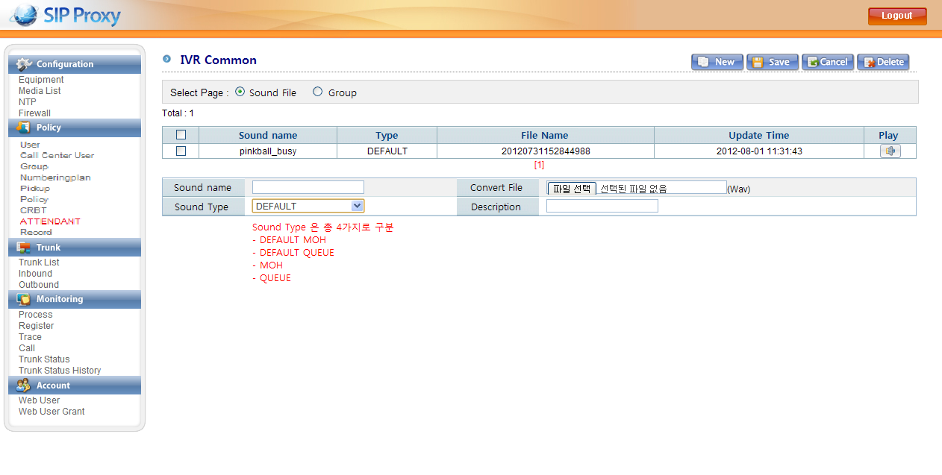
II. nx IVR
4. Source Upload

Slide 53
II. nx IVR
4. Source Upload
Sound Name | Sound name
Convert File | Source upload
Sound Type | Default moh is the source by default, when part of a group that does not. Moh is moh source of that group Default Queue is queue of the default source Queue source of the queue group
Description | Description

Slide 54
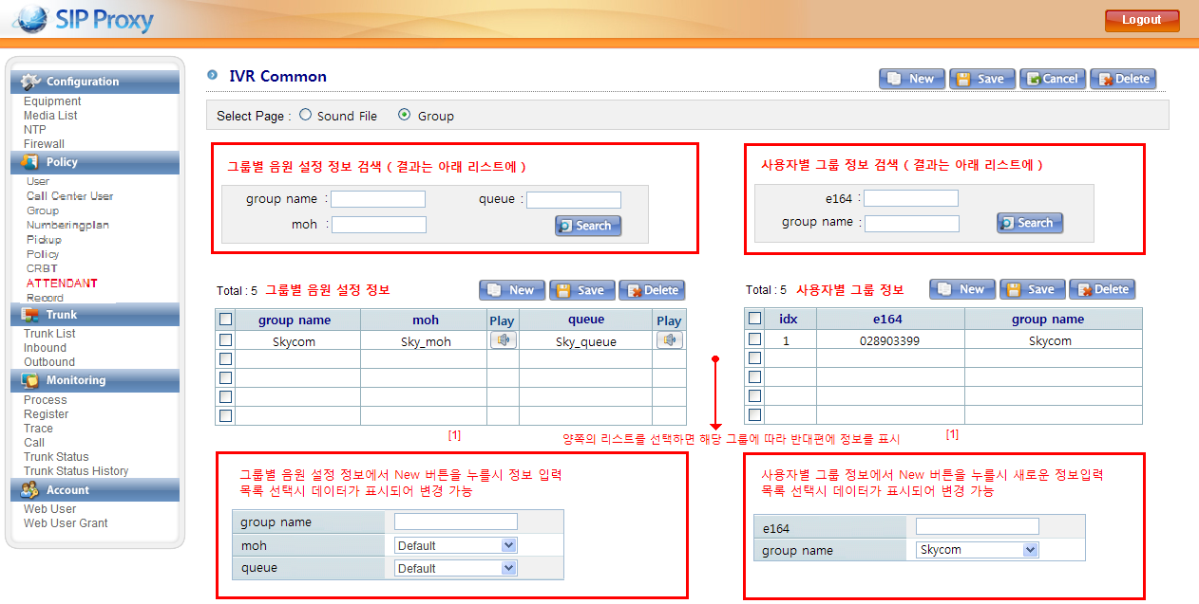
II. nx IVR
5. Source Setting for Groups

Slide 55
Ⅲ. nx VRS

Slide 56
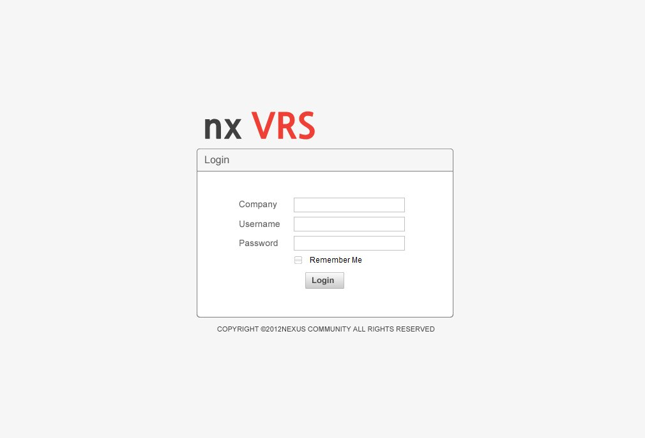
III. nx VRS
1. Execution & Log-In
1. Type in the address bar http:// ~ and hit Enter, the login screen appears.
2. Granted Username, Password and then click the login button to enter.

Slide 57
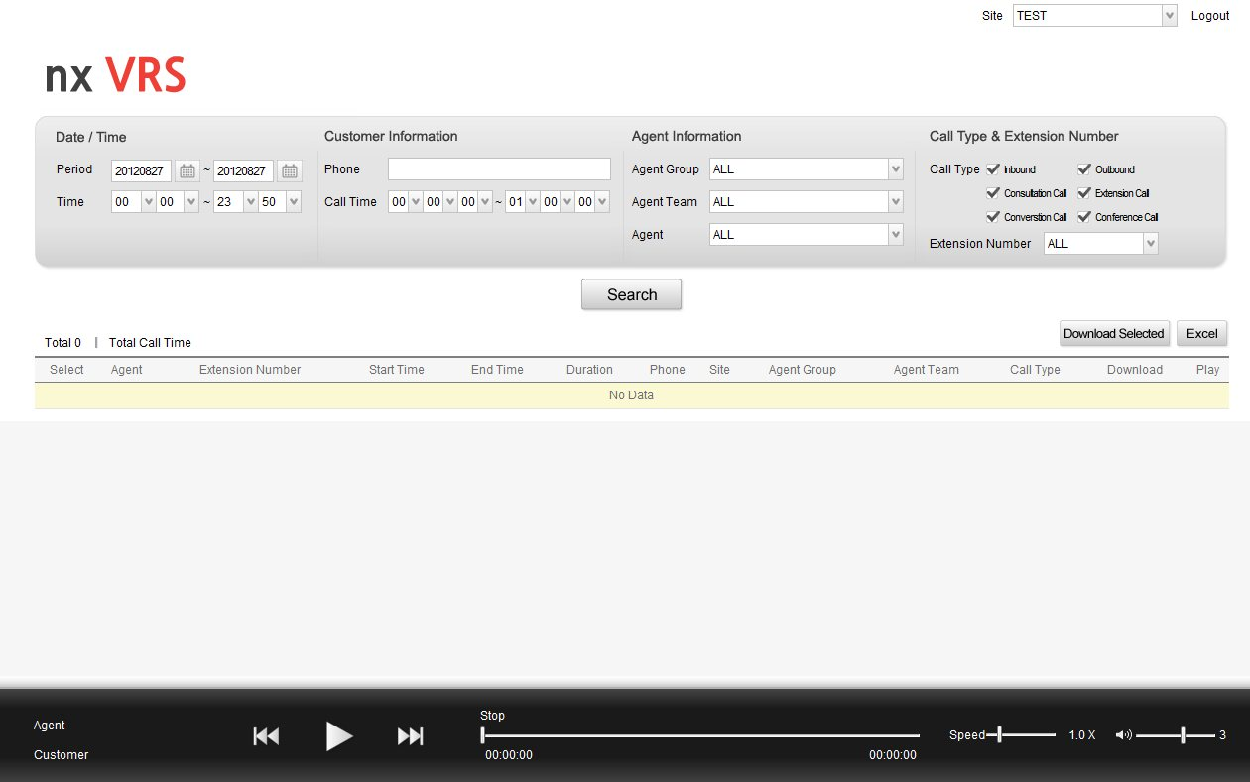
III. nx VRS
2. Screen Configuration
①
②
③

Slide 58
III. nx VRS
2. Screen Configuration
① Search zone
- Area where you can set values of several condition, the time of the inquiry recording
- The condition values are date/time, customer information, agent information
② List zone
- Area where you can check list of values ​​are retrieved by the different condition values
- Area where you can also download a single file, multiple files, and can be downloaded optionally playback and
conversion of excel file
③ Listening zone
- Area where you can listen and control selected recording file
- Area where you can check information of selected recording, current status when listening, and control speed and volume

Slide 59
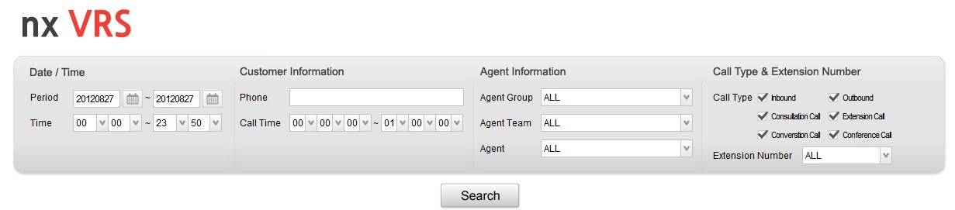
III. nx VRS
3. Data Retrieval
①
②
③
④
① Date/Time
- Period : It is set based on the current date. you can set the period that you want to search.
- Time : It is consists of hours : Minutes. You can set the time zone that you want to search.
② Customer Information
- Phone Number : You can search all regular telephone number and mobile number.
- Calling Time : It is consists of Hours : Minutes : Seconds, you can search total call time recorded.
③ Agent Information
- Agent Group : You can select agent group that you want to search.
- Agent Team : You can select agent team that you want to search.
- Agent : You can select agent that you want to search.
④ Call Type & Extension Number
- Call forms are can be multi check.
- Inbound and outbound call forms are can be searched, after checking inbound and outbound of call forms.

Slide 60
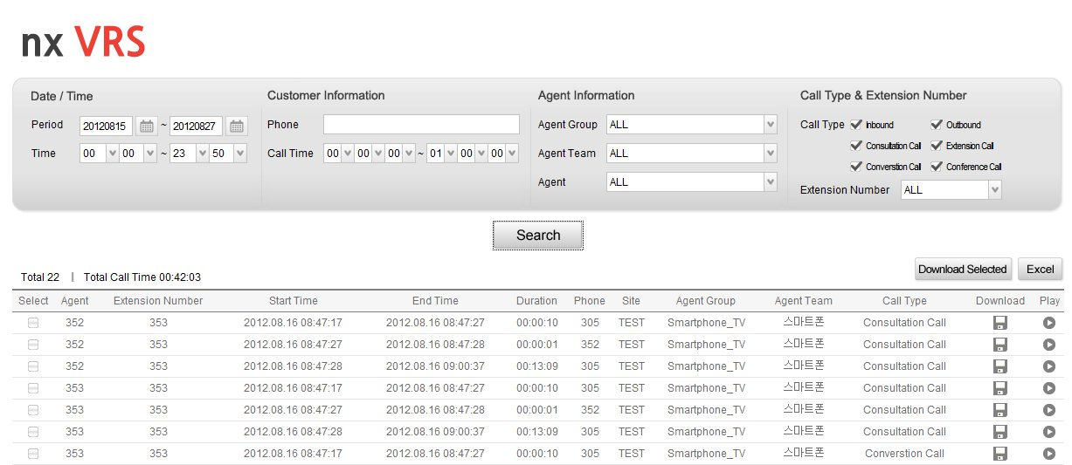
III. nx VRS
3. Data List
①
⑤
③
②
④

Slide 61
III. nx VRS
3. Data List
① The total number and total call time
- You can check all number of recording and call time, after setting the value of search conditions.
② Download
- When you click, you can save the file.
- The file name is automatically set to the end time, agent extension phone number_customer phone number_
start time_close time.
③ Select Download
- After checking download files and click button of download selected, and select the download of
the file can be saved.
- At this time, ....... ZIP file name is automatically set.
④ Play
- As the player is activated when you click to listen to the recorded file is selected.
⑤ excel
- At the click of a excel button, The list retrieved will be converted to Excel.

Slide 62
III. nx VRS
5. Listening
②
③
④
⑤
①
① Customer Information
- You can check agent listening and recording of the agent and customer information (contact details).
② Player
- Rewind : Rewind in 5-second increments when clicked once.
- Play / Pause : When the play button is clicked, the recorded file play. and the play button is converted to a pause button.
- Fast Forward : Fast forward in 5-second increments when clicked once.
③ Hours Process bar
- Displays the start and end time, indicating current status about recording listening.
④ Speed
- The maximum speed can be adjusted up to 2x.
⑤ Volume
- Up to three times the volume control is possible.

Slide 63
Ⅳ. nx Board

Slide 64
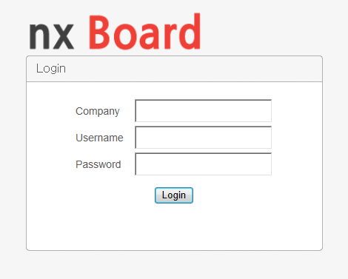
IV. nx Board
1. Execution & Log-In
1. URL : http://121.170.212.59:3001/login
2. Company : hungary
3. Username : 1
4. Password : 1

Slide 65
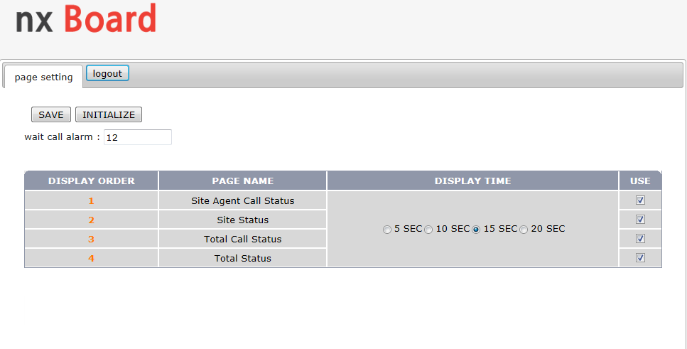
IV. nx Board
2. Setting
⑤
⑥
④
①
②
③
① DISPLAY ORDER
- You can change the order in which appear on the board.
- Change the display order of site agent call status is set 1 to 4, and change the display order of total status is set 4 to 1,
board first express total status and site agent call status in the very last.
② DISPLAY TIME
- You can set expressed on the board the time in 5-seconds increments.

Slide 66
IV. nx Board
2. Setting
③ USE
- You can select the page in which appear on the board.
- If you do not check the box, that page will not be expressed.
④ Wait Call Alarm
- The alarm rings when waiting call occurs more than setting call.
- When set to 12, waiting call more than 12 occurs, the alarm rings.
⑤ Save
- At the click of button, the setting is reflected.
⑥ Initialize
- The setting is initialized at the click of a button. (display time 5 seconds, all expressed on the board)

Slide 67
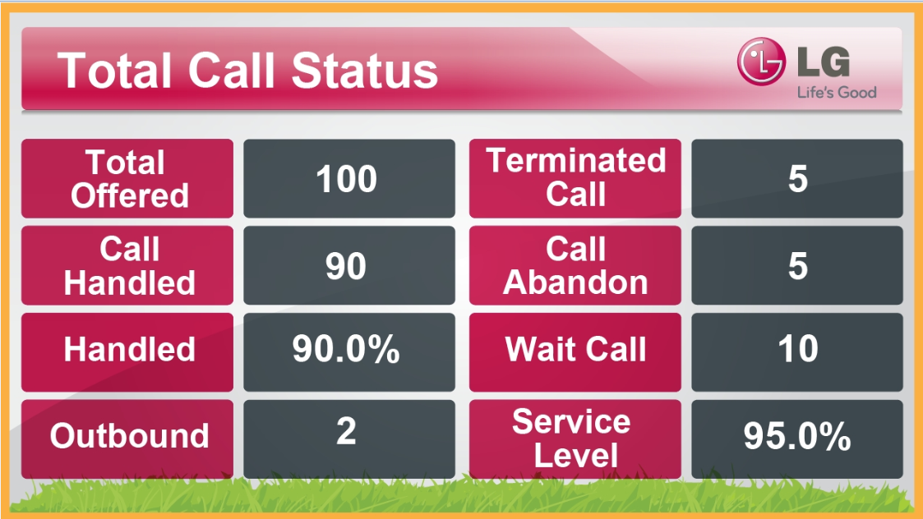
IV. nx Board
3. Board Screen – Total Call Status
①
②
③
④
⑤
⑥
⑦
⑧
① Total Offered : Total available Incoming call for CIC flow
② Terminated Call : Disconnected call without transfer Trying to CIC or Agent company
③ Call Handled : Respond call by CIC operator
④ Call Abandon : Abandon call on CIC flow
⑤ Handled : Rate = ③ / ① * 100% Handled call rate by CIC
⑥ Wait Call : Wait call on CIC flow
⑦ OutBound : Outbound call
⑧ Service Level : Respond call within 20 second / Offered call on CIC

Slide 68
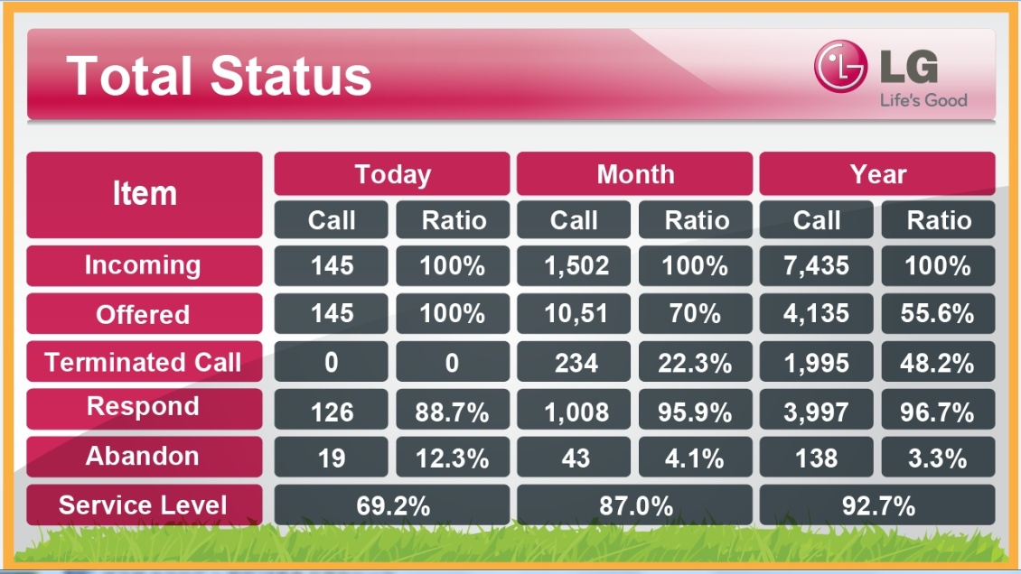
IV. nx Board
4. Board Screen – Total Status
①
②
③
④
⑤
⑥
① Incoming : Total Incoming call / Rate = 100%,
② Offered : Available incoming call on CIC flow / Rate = ② / ① * 100%,
③ Terminated : Diverted call to Agent center / Rate = ③ / ② * 100%,
④ Respond : Respond call by CIC operator / Rate = ④ / ② * 100%,
⑤ Abandon : Abandon call on CIC flow / Rate = ⑤ / ②
⑥ Service Level : Respond call within 20 second / Offered call on CIC

Slide 69
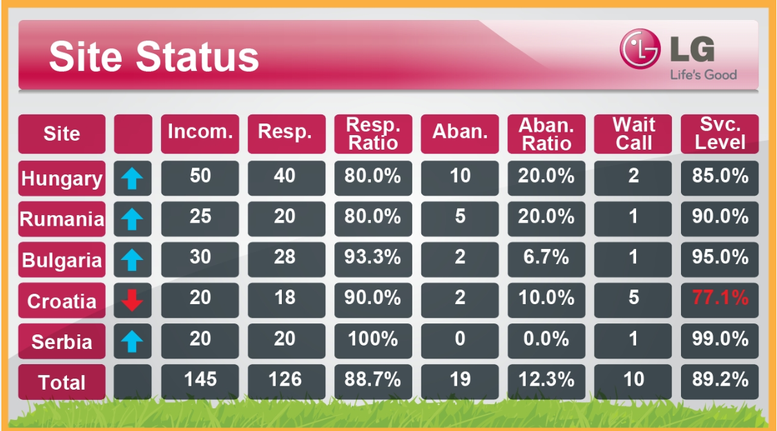
IV. nx Board
5. Board Screen – Site Status
①
②
③
④
⑤
⑥
⑦
① Incoming : Total Incoming call
② Resp : Respond call by CIC operator / Rate
③ Resp.Ratio : ② / ① * 100%,
④ Aban: Abandon call on CIC flow
⑤ Aban. Ratio : ④ / ① * 100%,
⑥ Wait Call : Wait call on CIC flow
⑦ Service Level : Respond call within 20 second / Offered call on CIC
Service Level above of 80% , Service Level less than 80%

Slide 70
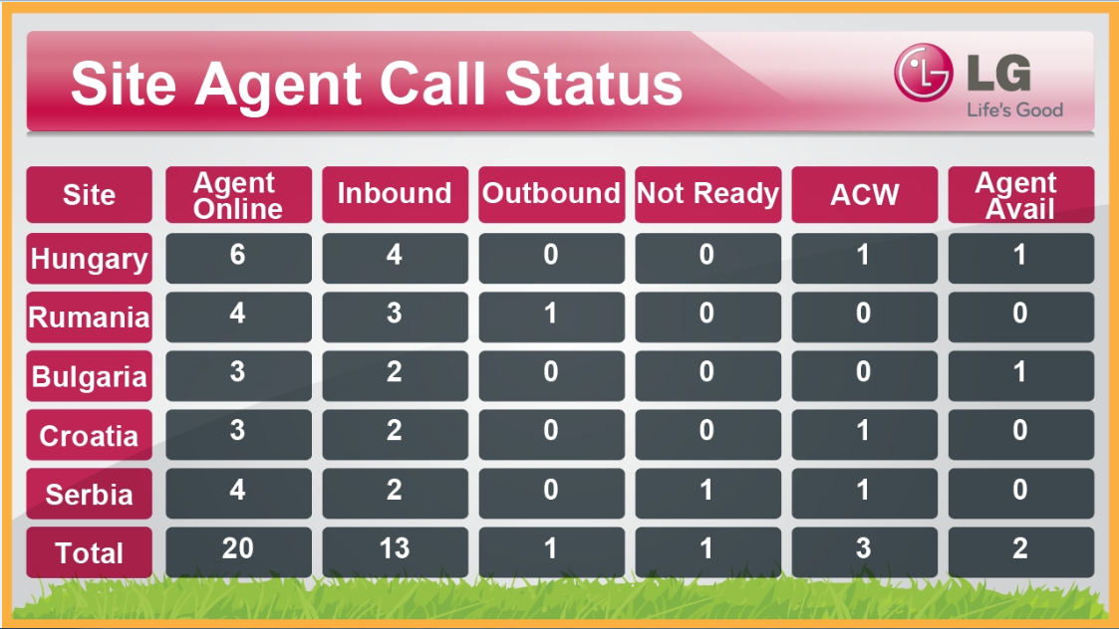
IV. nx Board
6. Board Screen – Site Agent Call Status
①
②
③
④
⑤
⑥
① Agent Online : Total Incoming call
② Inbound : Agent Number of Inbound
③ Outbound : Agent Number of Outbound
④ Not Ready : Agent Number of Not Ready
⑤ ACW : Agent Number of After Call Work
⑥ Agent Avail : Agent Number of Available

